Slide 1

Prediction/Analysis of Popularity of Top 50 Spotify Songs 2019
Spencer Standish, Keziah Thomas
April 12th, 2023
ITE 5201 Humber College

Slide 2


Problem Statement and Dataset Discussion
Prediction/Analysis of Popularity of Top 50 Spotify Songs 2019
This dataset contains the following variables/columns:
track_name - Name of the Track
artist_name - Name of the Artist
Genre - The genre of the track
beats_per_minute - The tempo of the song.
Energy - The energy of a song - the higher the value, the more energetic. song
Danceability - The higher the value, the easier it is to dance to this song.
2

Slide 3


Problem Statement and Dataset Discussion
Loudness(dB) - The higher the value, the louder the song.
Liveness - The higher the value, the more likely the song is a live recording.
Valence - The higher the value, the more positive mood for the song.
Length - The duration of the song.
Acousticness - The higher the value the more acoustic the song is.
Speechiness - The higher the value the more spoken words the song contains.
Popularity - The higher the value the more popular the song is.
We analyze the popularity of the songs based on beats_per_minute, Energy, Danceability, Loudness(dB), Liveness, Valence, Length, Acousticness and Speechiness
3

Slide 4
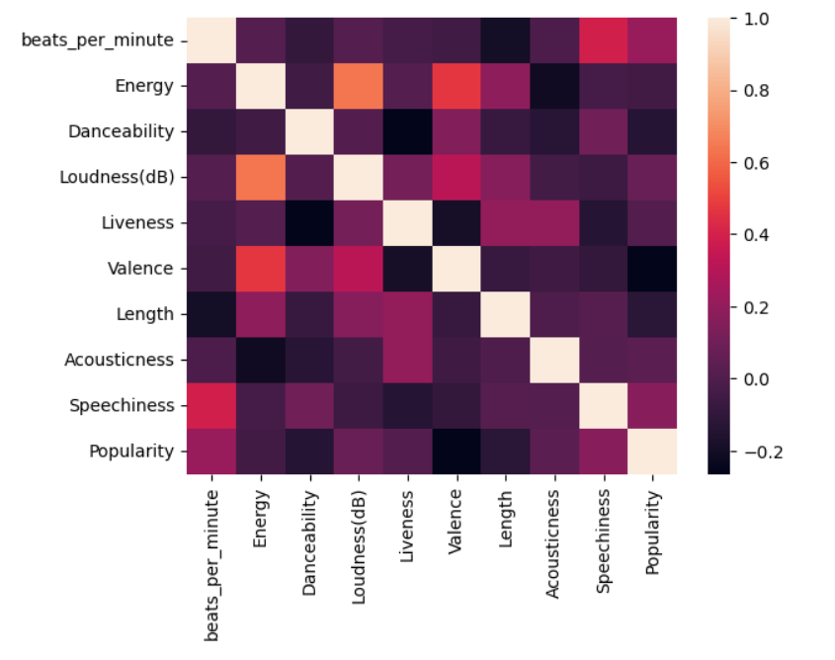
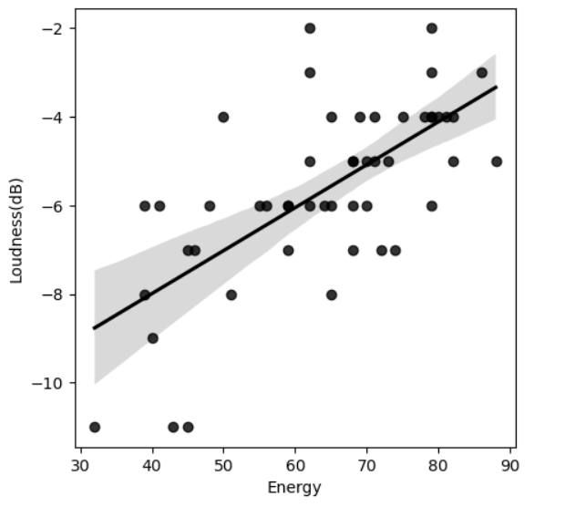
Problem Statement and Dataset Discussion
The heatmap plot shown below uses spearman method to plot the correlation coefficient rank between different variables.
Based on the heatmap where lighter colors indicate high correlation and darker colors indicate low correlation, we can conclude that Energy and Loudness have a positive correlation compared to the rest of the variables.
4

Slide 5
Proposed Analytical/Predictive Model
We used a linear regression model for this dataset as we work with numerical data. We don’t use logistic regression model or K-Nearest Neighbor model as we have to analyze the reason behind the popularity of songs based on numerical measures and not whether the song is popular or not.
We split the dataset 7:3 for training and testing using random state of 30.
We then analyze the error and calculate the mean absolute error, mean squared error and the root mean squared error.
We aim to achieve the least possible value for the aforementioned metrics, especially the root mean squared value.
5

Slide 6
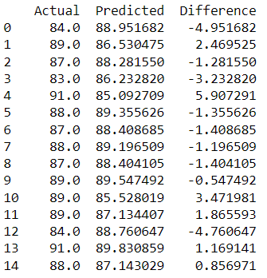
Proposed Analytical/Predictive Model
The image in the slide show how much accuracy and our model possesses.
Mean Absolute Error:
2.39197463658397
Mean Squared Error:
8.362163216805305
Root Mean Squared Error:
2.891740516852317
6

Slide 7
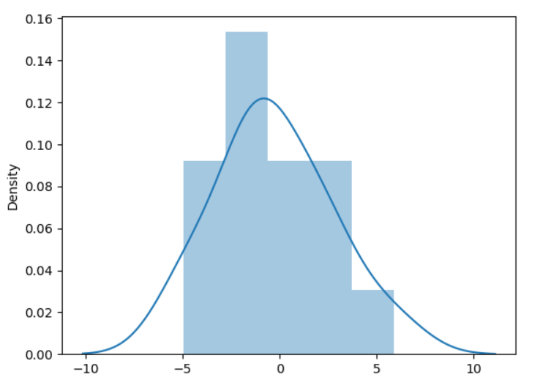
Proposed Analytical/Predictive Model
As we can see, the error terms resemble closely to a normal distribution.
So we can move ahead and make predictions using the model in the test dataset.
7
Notes:
7

Slide 8
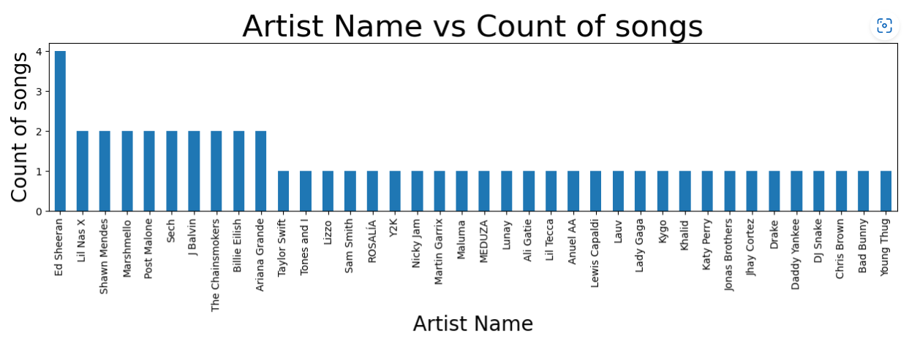
Results and Discussion
8
Notes:
8

Slide 9

Does the most songs in top 50 = #1 song?

Slide 10
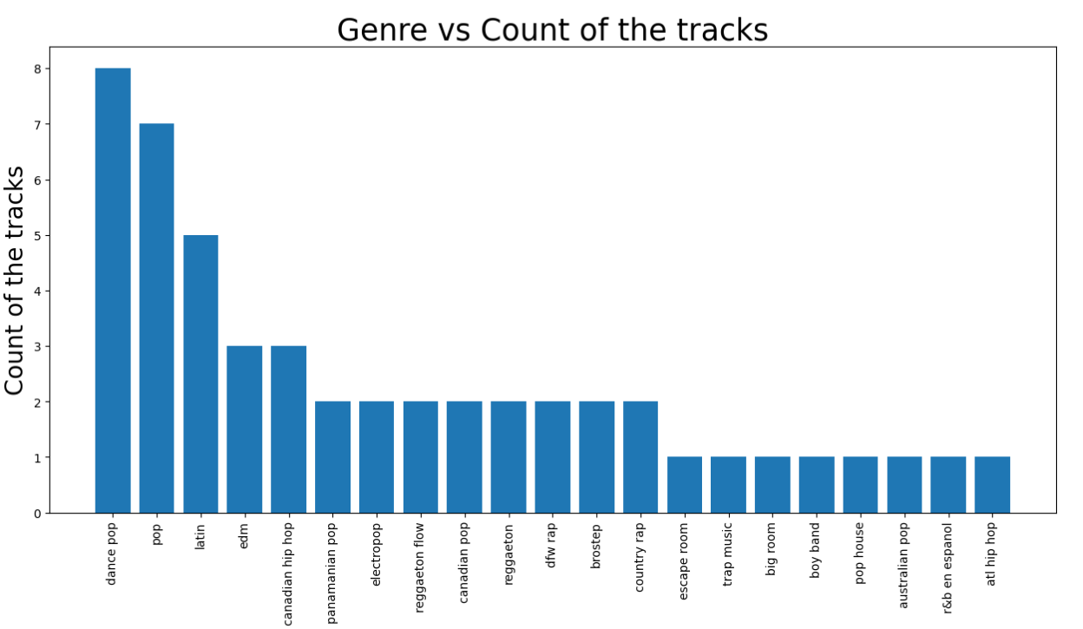
Results and Discussion
10
Notes:
10

Slide 11

Results and Discussion
Popularity of the song doesn’t necessarily depend on the most popular genre or the artist who released the most songs in 2019, but instead…
11
Notes:
11

Slide 12
Results and Discussion
As per our analysis, we can observe that popularity actually depends on:
beats_per_minute
Energy
Danceability
Loudness(dB)
Liveness
Valence
Length
Acousticness
Speechiness
12
Notes:
12

Slide 13
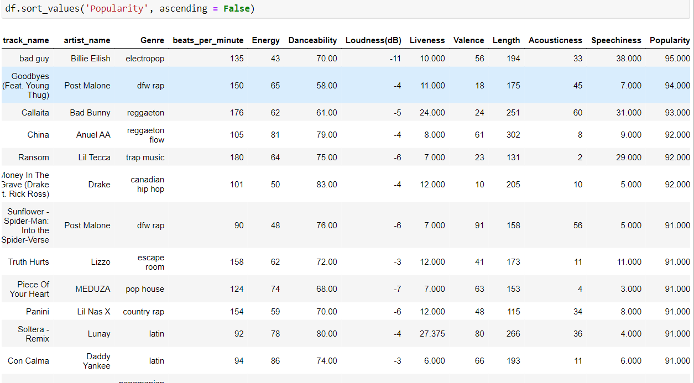
Results and Discussion
13
Notes:
13

Slide 14

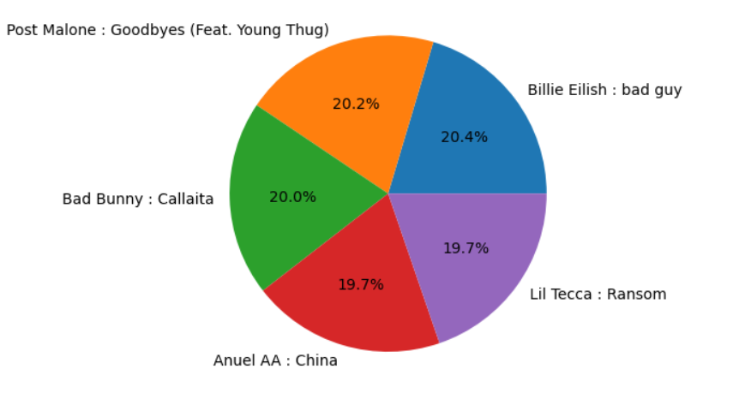
Results and Discussion
Top 5 popular songs and artists

